Slide 1
AWSA-S3

Slide 2
S3
Object based, not block based
0 – 5TB in size
Unlimited storage, you pay by Gigs
Files stored in buckets – they are a universal namespace, accessible globally. When you create an S3 bucket it generates a unique domain name
https://s3-us-east-1.amazonaws.com/sidtelang
Notes:
Object based storage is eventually consistent, block based is strongly consistent. Object based storage has an identifier and meta data, hence can be geographically accessible, block based storage is split up in blocks without any meta data, performance reduced during geographic distribution. Block based storage can be used for mount points

Slide 3
Data consistency
Read after write consistency for PUTS of new objects
Eventual consistency for overwrite PUTS and DELETES (takes time to propagate)
S3 is object based
Key is the name
Value is the byte sequence (data)
Version ID
Metadata (data about data)
Subresources
ACL (access control lists)
Torrents

Slide 4
Built for 99.99% availability, amazon guarantee 99.9% availability
11*9 durable 99.999999999
Tiered storage available
Lifecycle management
Secure data using ACL (access control lists) and bucket policies

Slide 5
S3 Tiers
S3 Standard – 99.99% availability and 11 9’s durability. Redundant across multiple AZs, can sustain loss at 2 facilities
S3 IA (Infrequently accessed) – 11 9’s durability, 99.9% availability and durability but cost is less to store but retrieval fee higher
S3 IA One Zone – 99.5% available and 11 9’s durability durable. Only stored in 1 AZ. Lower cost
Glacier – cheapest. Used for archival only. Expedited, Standard or Bulk
S3 Intelligent Tier - this basically monitors objects and moves them automatically to IA. No retrieval fee but it charges fee for each object stored

Slide 6
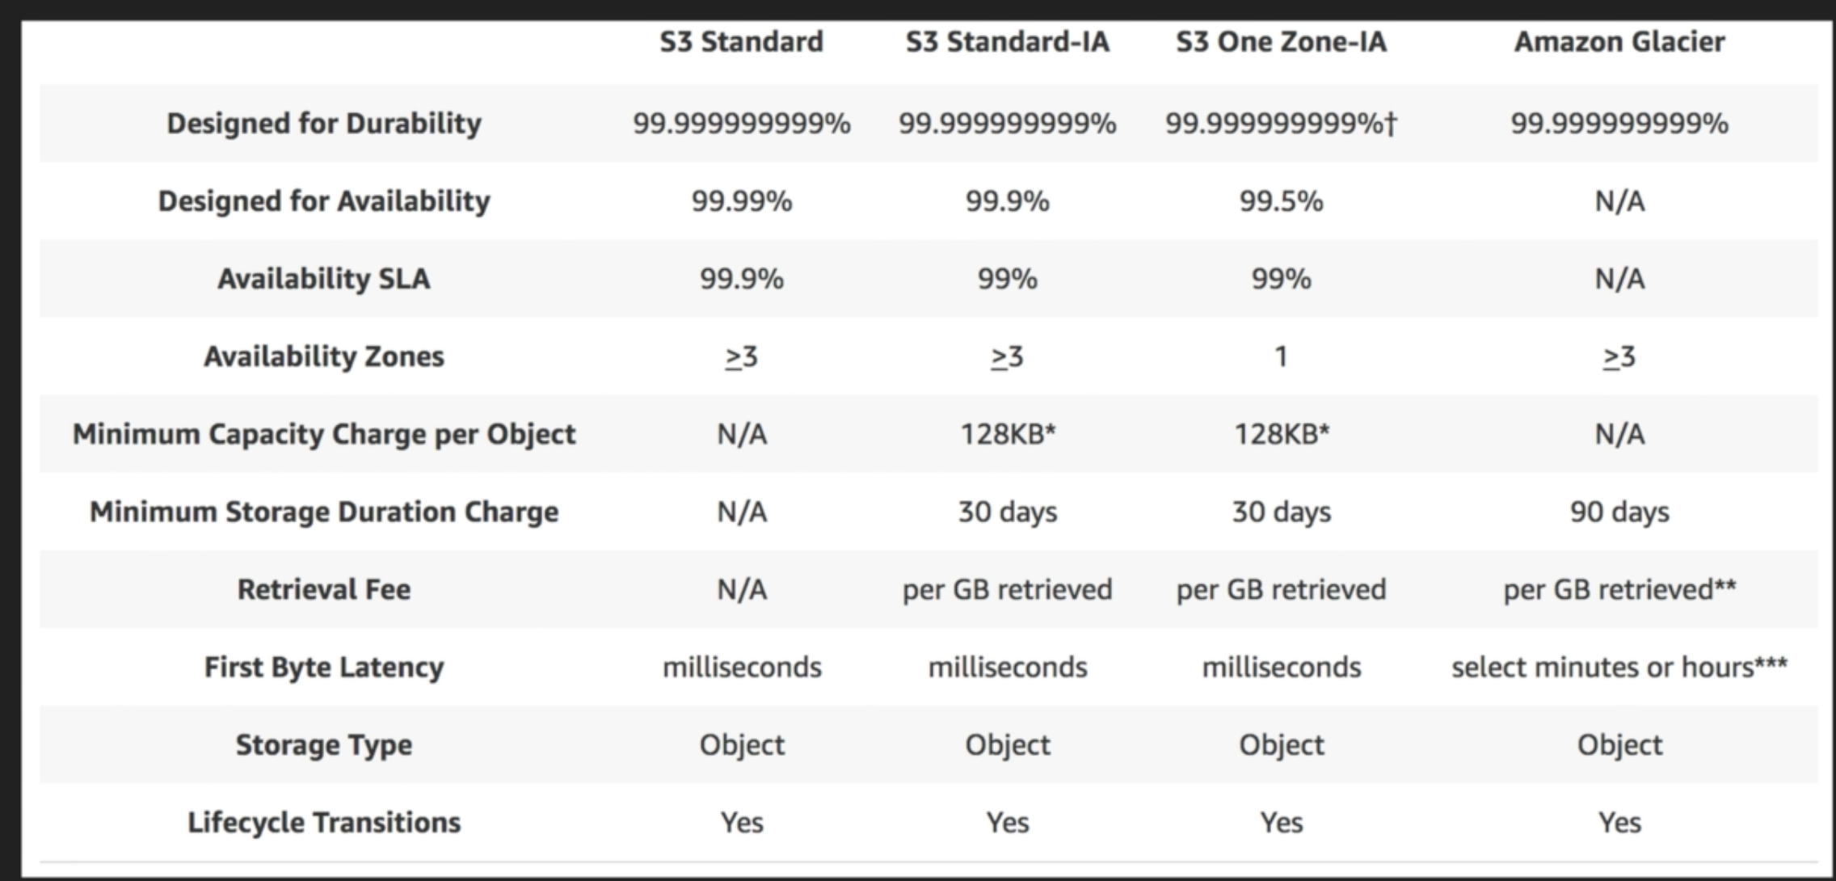

Slide 7
RRS – 99.99 availability and durability

Slide 8
Charges
Storage – per Gig basis
Number of requests
Storage management pricing – tagging (metadata)
Data transfer (cross region replication)
Transfer acceleration – fast easy secure long distance transfer (used cloud front distributed edge locations)
Notes:
Edge locations are datacenters located in different parts of the world, Behind the scene, Files are uploaded to the edge location closest to you and synced to S3 using AWS backbone.

Slide 9
3 types of storage – S3 standard, RRS, IA
Encryption – client side, server side – KMS, SSE-S3 (AWS managed), Access to buckets controlled by ACL, bucket policy.
By default buckets are private

Slide 10
Versioning
Stores all versions of files, even deleted ones are stored with delete marker
Once enabled, it can only be suspended
Integrates with lifecycle rules
MFA can be used for deletion

Slide 11
Cross region replication
Must be enabled in both destination and source bucket
Only new uploads will get replicated
Existing files need to be replicated using AWS CLI
Deletes and delete markers are not replicated
You cannot replicate to multiple buckets or using daisy chaining
CRR Monitor. needs to be deployed, not ready made

Slide 12
S3 Lifecycle policies
Can be applied to current and previous versions
Transition to Standard IA (30 days after creation)
Archive to Glacier (60 days after IA) This only applies if IA is selected.
Data can be moved to Glacier within 1 day directly
AWS SDK can be used to put data directly in Glacier vault without lifecycle policy
Expiration policy can be set and permanent deletion can be done
Multi part upload cleanup can be done

Slide 13
Content Distribution Network (CDN)
Edge Location: content cached here. Not same as AZ or Region. Not just read only, you can write to it and it will be uploaded to Origin, objects expire after TTL, can clear cached objects but you will be charged
Origin: Origin of files that CDN will distribute. This can either be an S3 bucket, EC2 instance, ELB or Route53
Distribution: collection of Edge locations. Web distribution used for websites, RTMP used for media

Slide 14
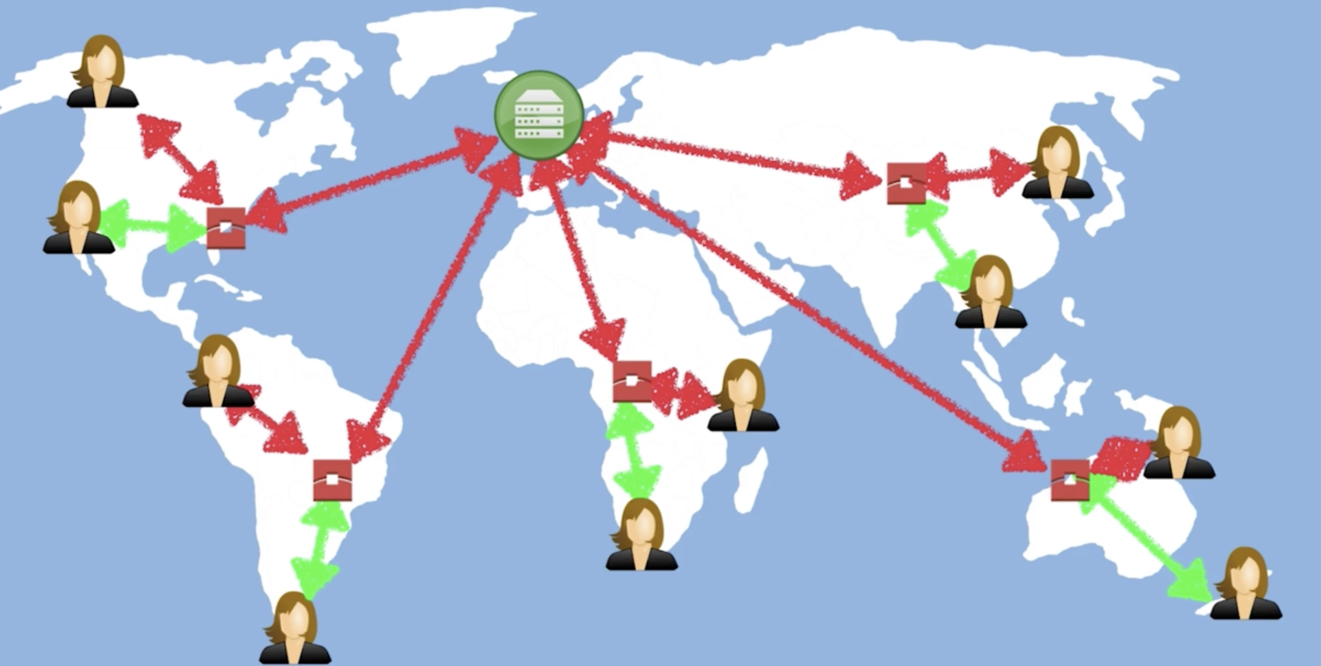

Slide 15
S3 Encryption
In Transit - SSL/TLS
At REST –
Server side
SSE-S3 (S3 managed keys) AES 256
SSE-KMS
SSE-C (customer provided keys)
Client side encryptions

Slide 16
Storage Gateway
Connects an on premise s/w appliance with cloud based storage
Seamless integration between on premise IT env and AWS storage infra
Virtual appliance running on hypervisor
Available to download as a Virtual machine image on DC host, supports VMWare Esxi, Microsoft Hyper-V

Slide 17

Types of Storage GW
4 types of storage GW
NFS File GW – flat files, word files, PDF
Volume GW iSCSi – block based storage
Stored volumes
Cached volumes
Tape GW

Slide 18
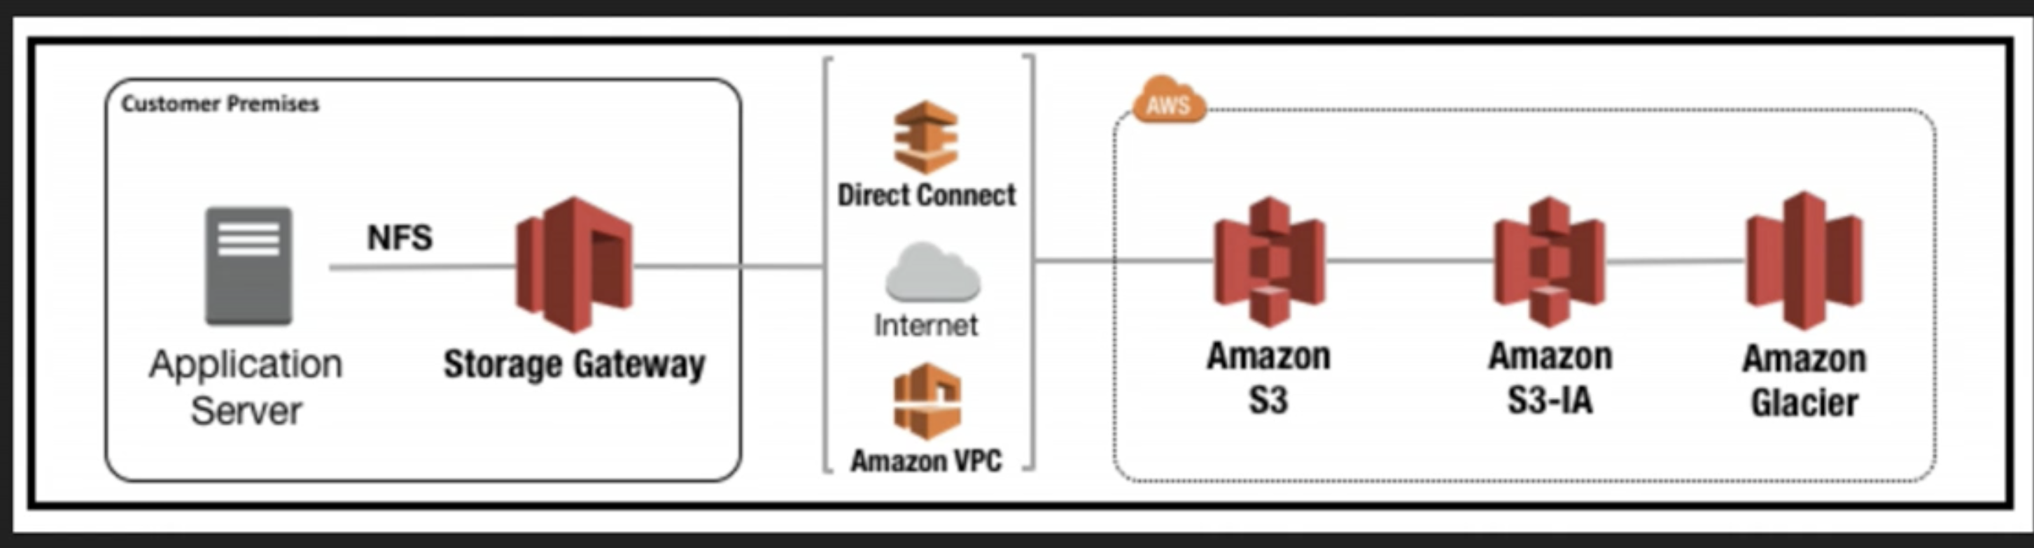
File GW

Slide 19
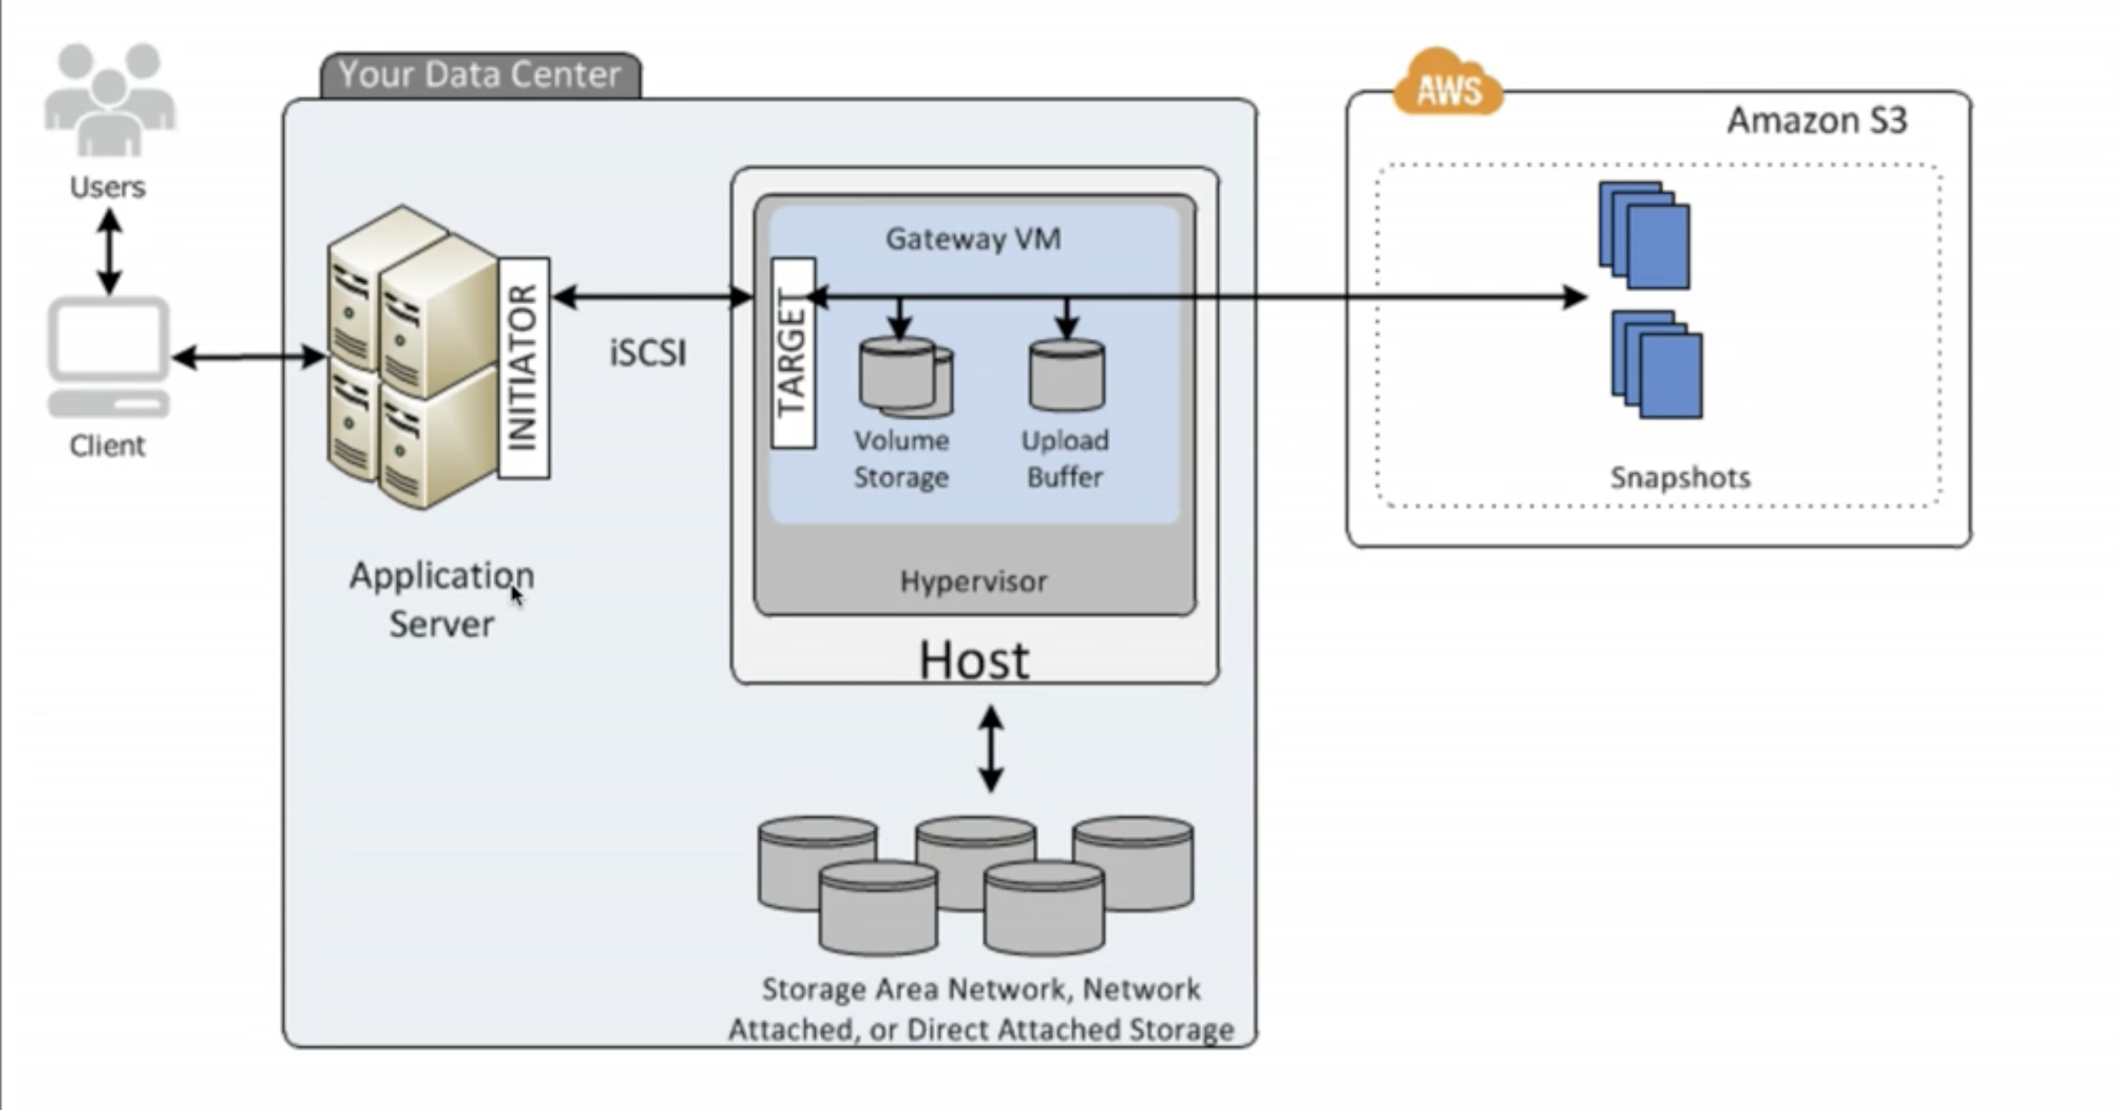
Volume GW
Volume GW – 1 – 16TiB
On premise volumes are async backed to AWS EBS snapshot

Slide 20
Cache storage
Volumes are stored on S3 as primary and most frequently accessed data is stored in cached volume on prem. 1- 32TiB

Slide 21
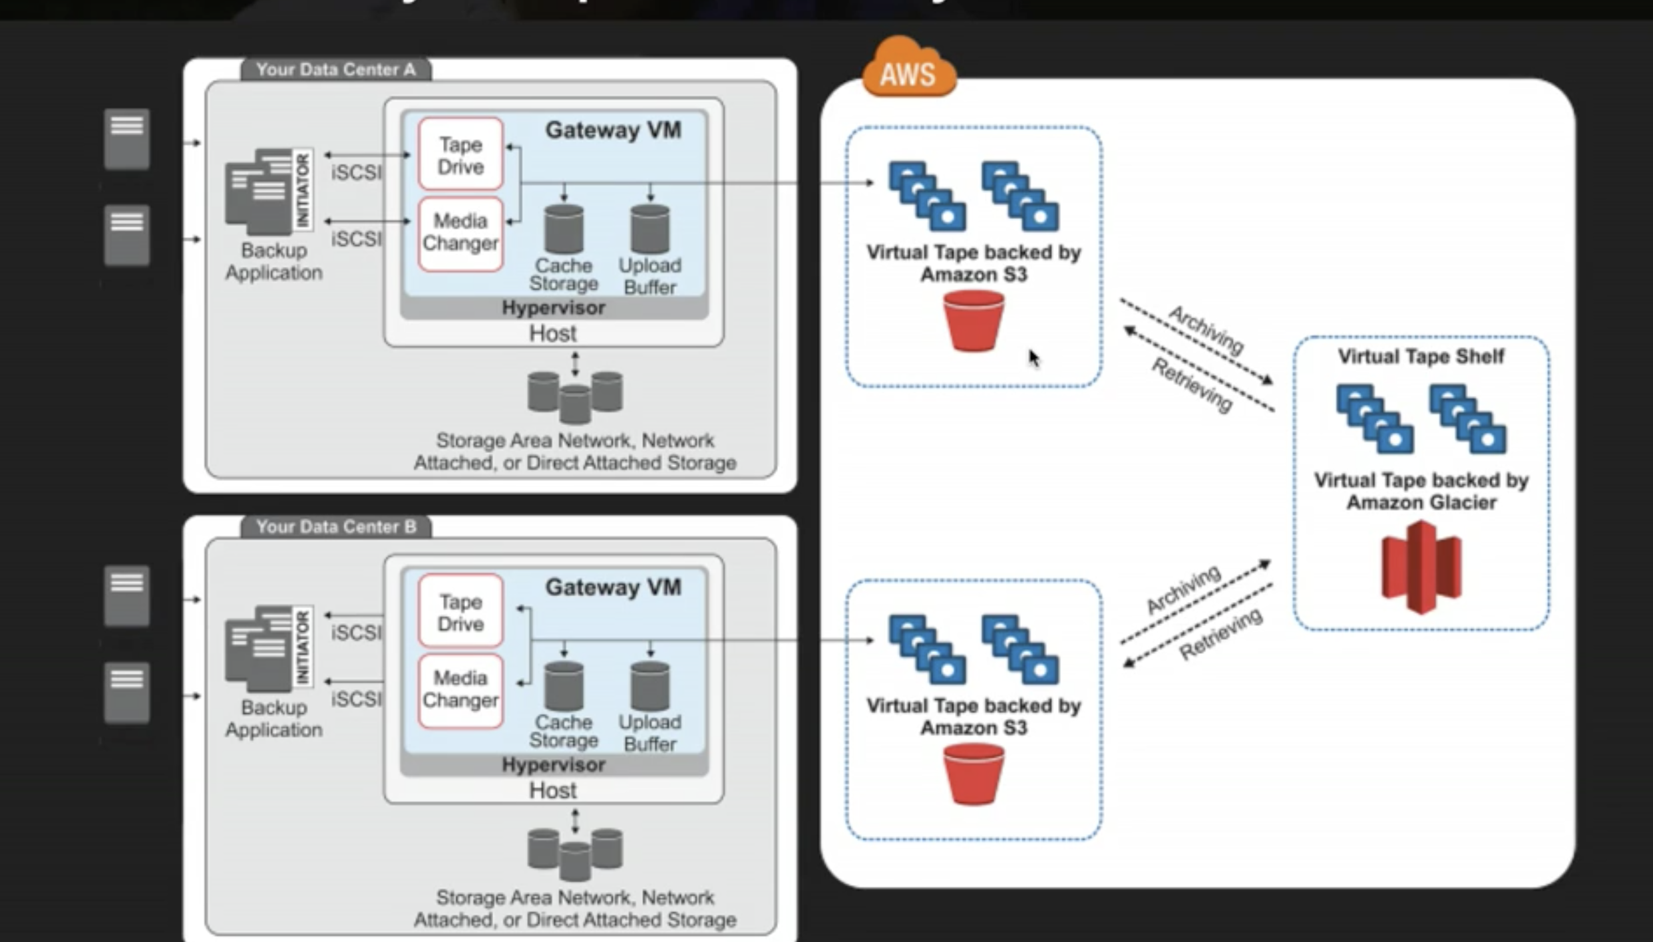
Virtual Tape Storage

Slide 22
Differences between GWs
Virtual Tape Library – popular backup apps like NetBackup, Veeam for existing backup systems using tapes, stored on S3 for immediate access, can be archived to Glacier
Cached Volumes – To save storage costs, if you have large amount of data but don’t want to store everything on premise, low latency access of cached data set
Stored Volumes – Store volumes as EBS on S3, low latency access of entire dataset asynchronous
Flat files – file Gateway

Slide 23
Storage GW
All data is secured using SSL
HIPAA Eligible and PCI compliant
Hardware appliance - Dell EMC PowerEdge R640 server

Slide 24
Import/Export (legacy service) & Snowball
Accelerates large amounts of data transfer into and out of cloud, using portable storage device
Snowball
Snowball – PB scale data transfer appliance, by passes internet, transfer to S3 done by AWS, costs 1/5th of high speed internet transfer, 80TB snowballs available in all regions, tamper resistance enclosure, 256 AES security, snowball can be tracked, software erasure (so data cannot be hacked into)
Snowball Edge – it has compute capabilities, 100TB device
Snowmobile – 100PB device on a trailer

Slide 25
S3 transfer acceleration
Instead of uploading to S3, upload to edge location (that will be transferred to S3) with different URL
You can test upload speeds, you can enable or suspend. Once enabled it will give you an endpoint different from S3 URL

Slide 26
Object size exceeds limit error – can be fixed by enabling multipart upload
Largest object added in single put is 5GB, for objects larger than 100MB consider multipart upload

Slide 27

Developer Associate Begins

Slide 28
Security
Bucket Policies – at bucket level
ACL – At object/file level
By default, new bucket is private

Slide 29
Policies
ACL – gives access to accounts, read, write, delete
Bucket policy – policy generator can generate JSON

Slide 30
Encryption
In transit: SSL/TLS
At Rest:
SSE S3 (s3 managed keys) AES 256 bit encryption
SSE KMS (AWS manages this for you): audit trail, you can use your own key or use default key
SSE C: Customer manages keys, but AWS manages encryption , decryption
Client Side Encryption

Slide 31
Encryption enforcement
PUT API call is upload
File encrypted at upload time, include x-amz-server-side-encryption parameter in header
For e.g. x-amz-server-side-encryption: AES256
This can be enforced using bucket policy which denies upload without this parameter OR from the console by enabling server side encryption

Slide 32
CORS
Cross origin resource sharing
Use case: To enable using JS to load content from a different bucket
Disabled by default default
Can specify origin URL, or * (all)

Slide 33
Content Delivery Network (CDN)
Lower latency for geographically distributed users
Content cached in closest edge location to user
TTL can be set
Cache can be force cleared by user but you will be charged for it
Content can be written to edge location as well, not just read
CDN optimized to work with S3, EC2, ELB, Route53
Transfer acceleration takes advantage of edge locations. For e.g. files can be uploaded to edge location, AWS takes care of moving to origin
Web distributions: HTTP for websites
RTMP: Real time messaging protocol for media streaming

Slide 34


Cloudfront distribution config
Multiple origins. For e.g. S3, EC2, ELB etc.
Behaviors. For e.g. path patterns, HTTP to HTTPS redirect
Custom error pages
Restrictions
Whitelist countries
Blacklist countries
Invalidations to clear cache

Slide 35

Performance
S3 designed to handle 100 PUT/LIST/DELETE per second and 300 GET requests per second
As of July 2018, it has gone up to 3500 PUT/sec and 5500 GET/sec
To handle greater GET intensive workloads use Cloudfront content delivery to get best performance
For mixed (GET, PUT …) workloads S3 uses keyname to determine which partition to put it in, can cause IO contention
Recommendation by AWS: add hexadecimal hash prefix to objects

